Slide 1
Monitoring & Logging for Deployed ML Models
Ensuring Reliability in Production AI Systems

Slide 2
Contents
01
02
Introduction to ML Monitoring
ML Lifecycle & Monitoring Role
03
04
Production Challenges
Logging Concepts & Monitoring vs Logging
05
06
Key Metrics, Architecture & Python Implementation
Tools & Best Practices

Slide 3

Why Monitoring Matters
Training a model is only half the job. Real-world data keeps changing, and models degrade over time without notice. Production systems need continuous tracking to remain reliable and accurate.
"If you don't monitor your model, you don't control it."
Models change
Data changes
Control requires visibility
Performance drifts silently in production
Real-world inputs evolve constantly
Monitoring is the foundation of trust

Slide 4
ML Lifecycle Recap
Monitoring is the final — and continuous — stage of the ML lifecycle. It closes the loop and ensures deployed models remain effective over time.
01
02
Data Collection
Data Cleaning
03
04
Model Training
Evaluation
05
06
Deployment (Flask/FastAPI)
Monitoring ← New Focus

Slide 5
What Can Go Wrong in Production?
Deployed models face a range of failure modes that are invisible without proper monitoring. These issues can silently degrade user experience and business outcomes.
Model Accuracy Drops
Data Distribution Changes
API Failures / Slow Responses
Predictions become unreliable over
time
Input patterns shift from training data
Latency spikes or endpoint errors
Unexpected User Inputs
Feature Pipeline Mismatch
Edge cases the model was never trained on
Preprocessing inconsistencies break predictions

Slide 6

Understanding Model Drift
Model drift refers to performance degradation over time as the real world diverges from training conditions.
There are two primary types:
Data Drift
Concept Drift
The input data distribution changes — the model sees inputs that look different from what it was trained on.
The relationship between input and output changes — the underlying patterns the model learned no longer hold.
Example: A fraud detection model trained on 2022 data may fail to catch new fraud patterns in 2025.

Slide 7
What Should We Monitor?
Effective monitoring covers five key dimensions across model behavior, data health, and system infrastructure.
1
Model Performance
Accuracy, RMSE, F1-score, and other task-specific metrics
2
Input Data Distribution
Statistical properties of incoming features vs. training data
3
Prediction Output Distribution
Are predictions shifting toward unexpected values?
4
API Metrics
Latency, error rates, and request volume
5
System Health
CPU usage, memory consumption, and infrastructure stability

Slide 8
What Is Logging?
Logging means recording events that occur during model execution. It is essential for debugging issues and auditing model behavior in production.
Types of Logs
Example Log Entry
Request logs — who called the API and when
Prediction logs — inputs received and outputs returned
Error logs — failures and exceptions encountered
Input: [age=45, income=50k]
Prediction: Approved
Response Time: 120ms

Slide 9

Logging vs. Monitoring
Logging and monitoring are complementary — logging feeds monitoring. Together they provide full observability of a
production ML system.
Dimension
Logging
Monitoring
Purpose
Records events
Tracks trends
Use Case
Debugging
Alerts & insights
Data Type
Raw event data
Aggregated metrics
Logging feeds Monitoring — you cannot monitor what you have not logged.

Slide 10
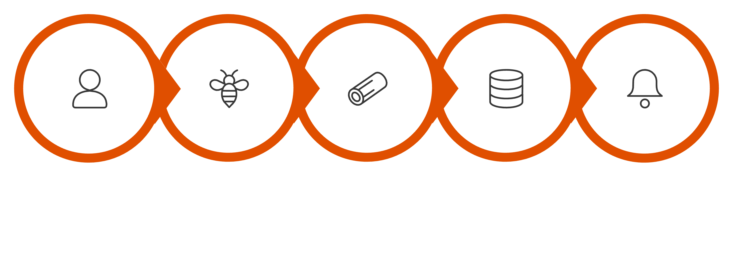
Monitoring Architecture
A production ML monitoring stack follows a layered architecture — from user request to alert. Each layer plays a distinct role in maintaining system observability.
Logging Layer
Dashboard & Alerts
User Request
API Layer
Storage
This pipeline ensures that every prediction is captured, stored, analyzed, and surfaced to operators when something goes wrong.

Slide 11
Logging in Python — The Basics
Python's built-in logging module makes it straightforward to capture events at different severity levels. Logs are stored in .log files for later review.
import logging
logging.basicConfig(filename='app.log', level=logging.INFO)
logging.info("Prediction successful")
logging.error("Model failed")
INFO
WARNING
ERROR
Normal operational events
Unexpected but non-critical issues
Failures requiring attention

Slide 12

Logging in FastAPI
Integrating logging into a FastAPI endpoint ensures every API call is recorded. This is critical for debugging production issues and auditing model usage.
from fastapi import FastAPI
import logging
app = FastAPI()
logging.basicConfig(level=logging.INFO)
@app.get("/predict")
def predict():
logging.info("Prediction endpoint called")
return {"result": "ok"}
Every call to /predict is logged automatically — giving you a full audit trail of model usage in production.

Slide 13
Monitoring Model Performance in Python
To monitor performance, compare model predictions against actual ground-truth values over time. Tracking accuracy trends reveals when a model begins to degrade.
from sklearn.metrics import accuracy_score
y_true = [1, 0, 1, 1]
y_pred = [1, 0, 0, 1]
acc = accuracy_score(y_true, y_pred)
print("Accuracy:", acc)
Compare predictions with actual values
Track metrics over time
Use labeled production data to evaluate real-world accuracy
A single snapshot is not enough — trends reveal drift

Slide 14
Detecting Drift in Python
A simple statistical check compares the mean of training data against new incoming data. If the difference exceeds a threshold, drift is flagged. This approach can be extended to more advanced drift detection libraries.
import numpy as np
train_mean = np.mean(train_data)
new_mean = np.mean(new_data)
if abs(train_mean - new_mean) > threshold:
print("Data Drift Detected!")
This is a starting point. Production systems should use dedicated drift detection tools like Evidently AI for robust, multi-feature analysis.

Slide 15

Tools for Monitoring
A mature ML monitoring stack combines infrastructure monitoring, visualization, log management, and ML-specific drift
detection tools.
Prometheus
Grafana
Open-source metrics collection and alerting toolkit — ideal for tracking API latency, error rates, and system health.
Visualization platform that connects to Prometheus and
other data sources to build real-time monitoring dashboards.
ELK Stack
Evidently AI
Elasticsearch, Logstash, and Kibana — a powerful suite for centralized log aggregation, search, and visualization.
ML-specific library for detecting data drift, model
performance degradation, and data issues in production.

Slide 16





Key Takeaways
Monitoring and logging are not optional — they are the foundation of trustworthy production ML systems.
Monitor Continuously
Log Everything
Track performance, data, and system health at all times
Requests, predictions, and errors — all must be recorded
Detect Drift Early
Use the Right Tools
Use statistical checks and dedicated tools to catch
degradation
Prometheus, Grafana, ELK, and Evidently AI form a complete stack
A model you cannot observe is a model you cannot trust. Build monitoring in from day one.

